Slide 1
Projeect Manajer : Anla Harpanda
Anggota : - Agel Deska Wisamulya
- Nadya Hermalia Putri
- Vania Ulimaz Rivani

Slide 2
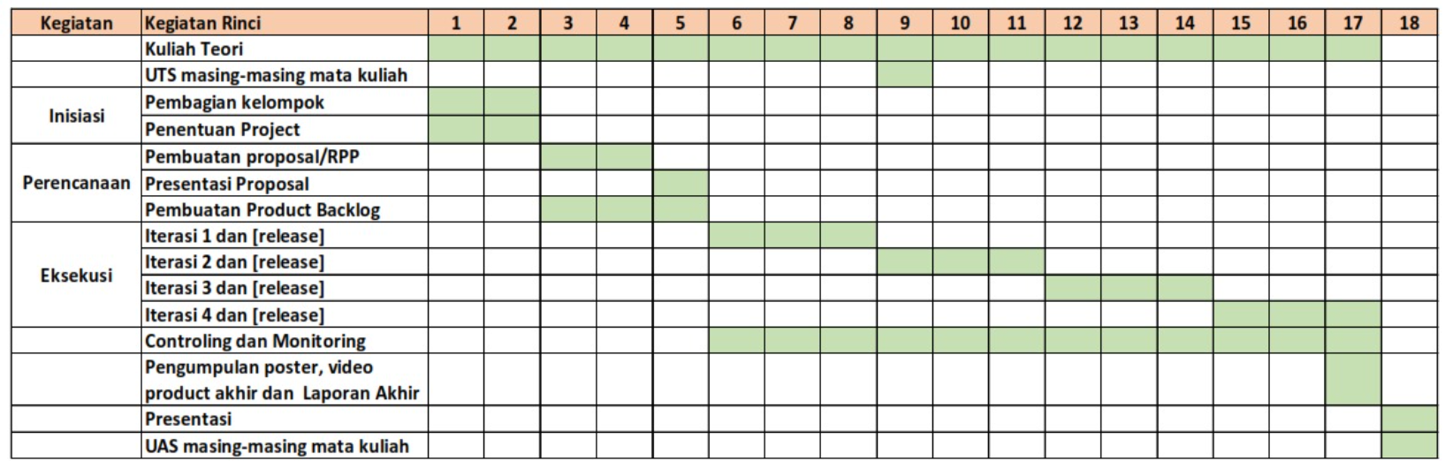
17/2
24/2
3/3
10/3
17/3
24/3
31/3
7/4
14/4
21/4
28/4
5/5
12/5
19/5
26/5
2/6
9/6
16/6

Slide 3
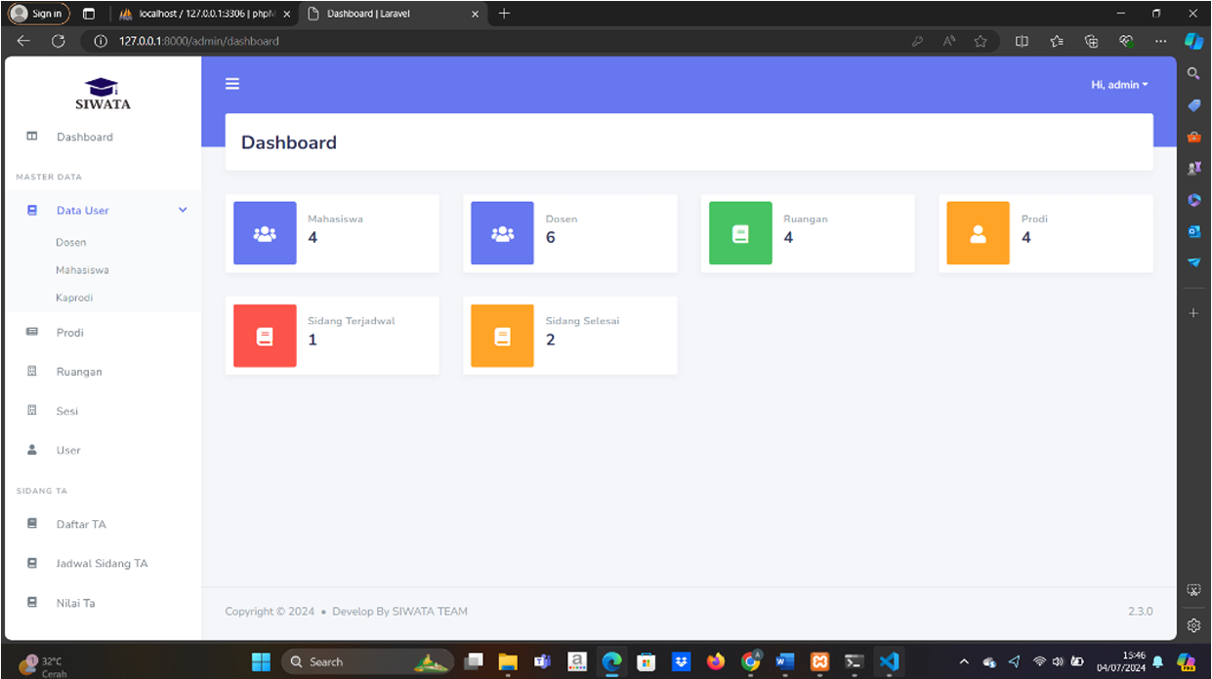
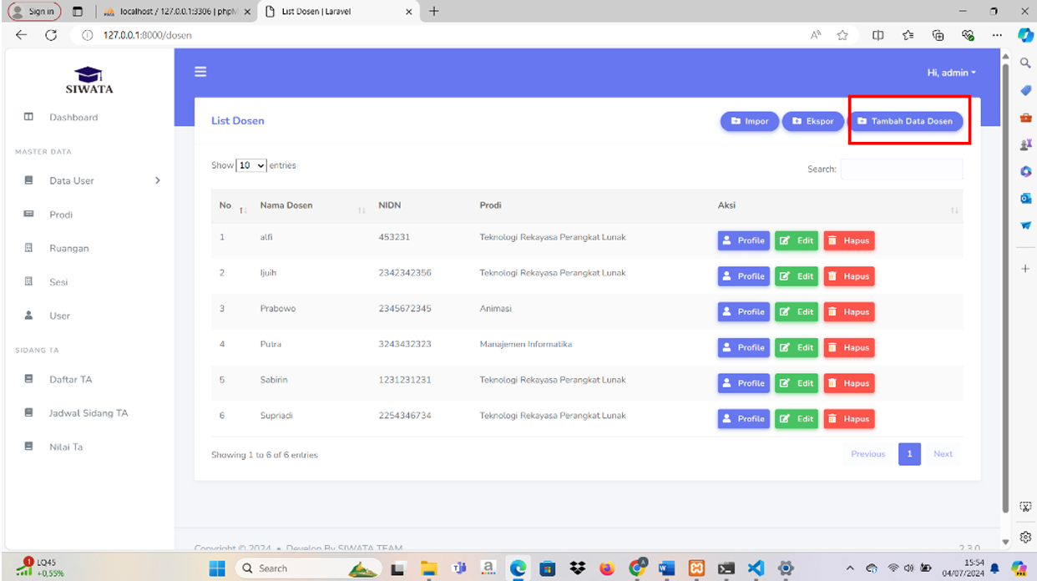
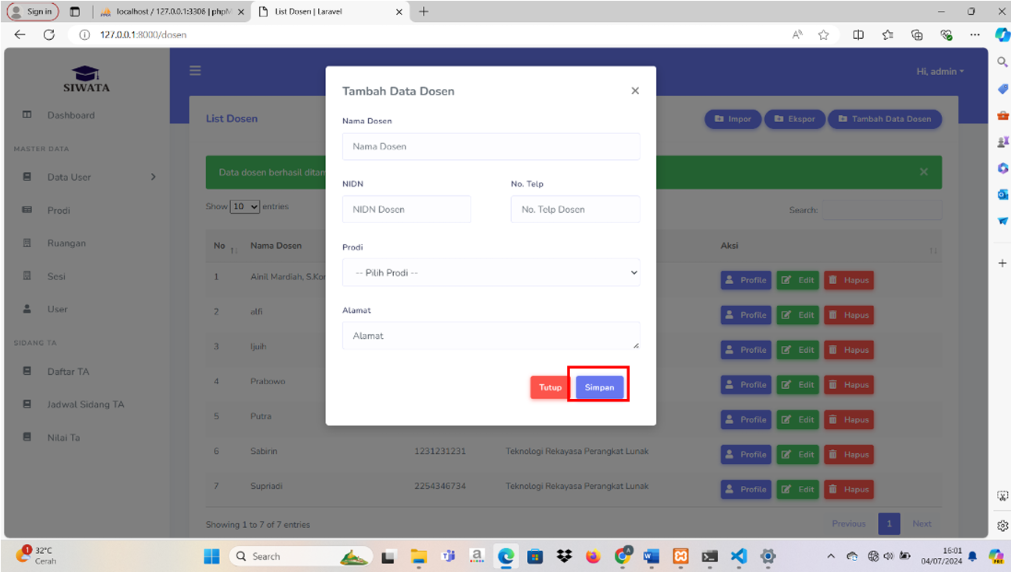
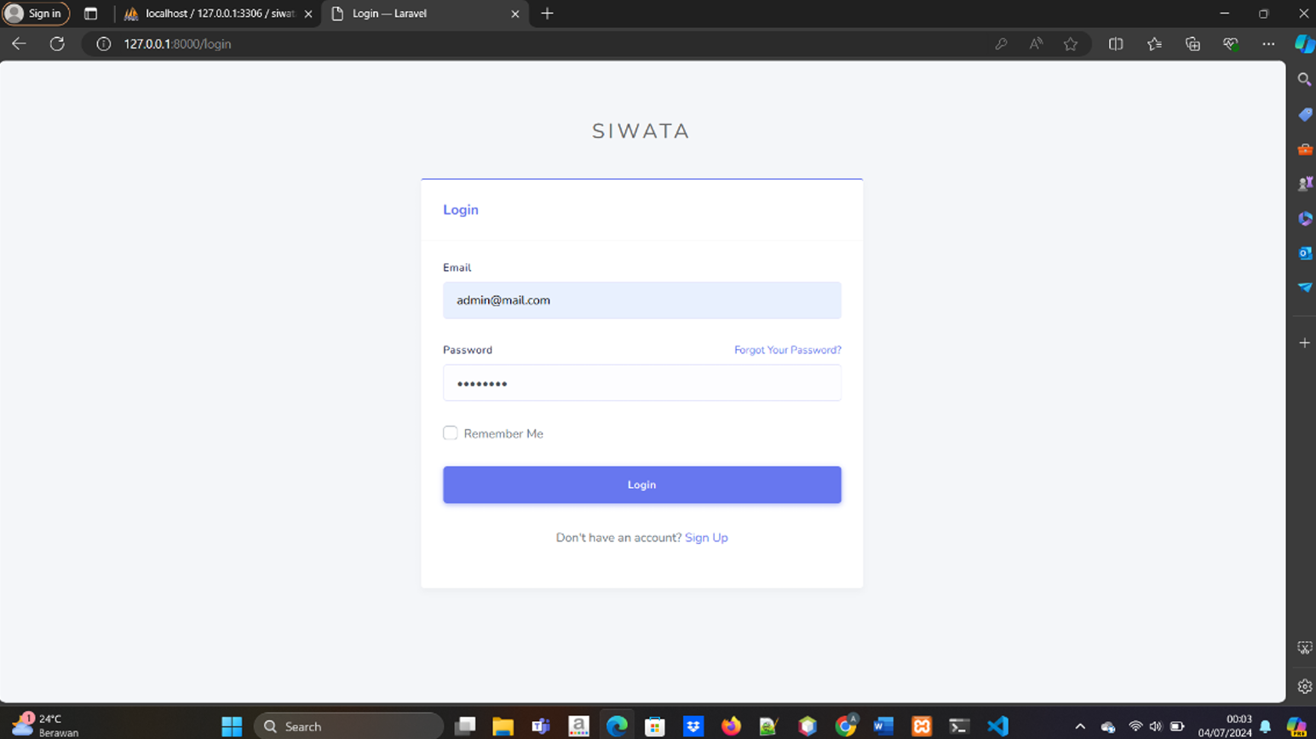

Slide 4
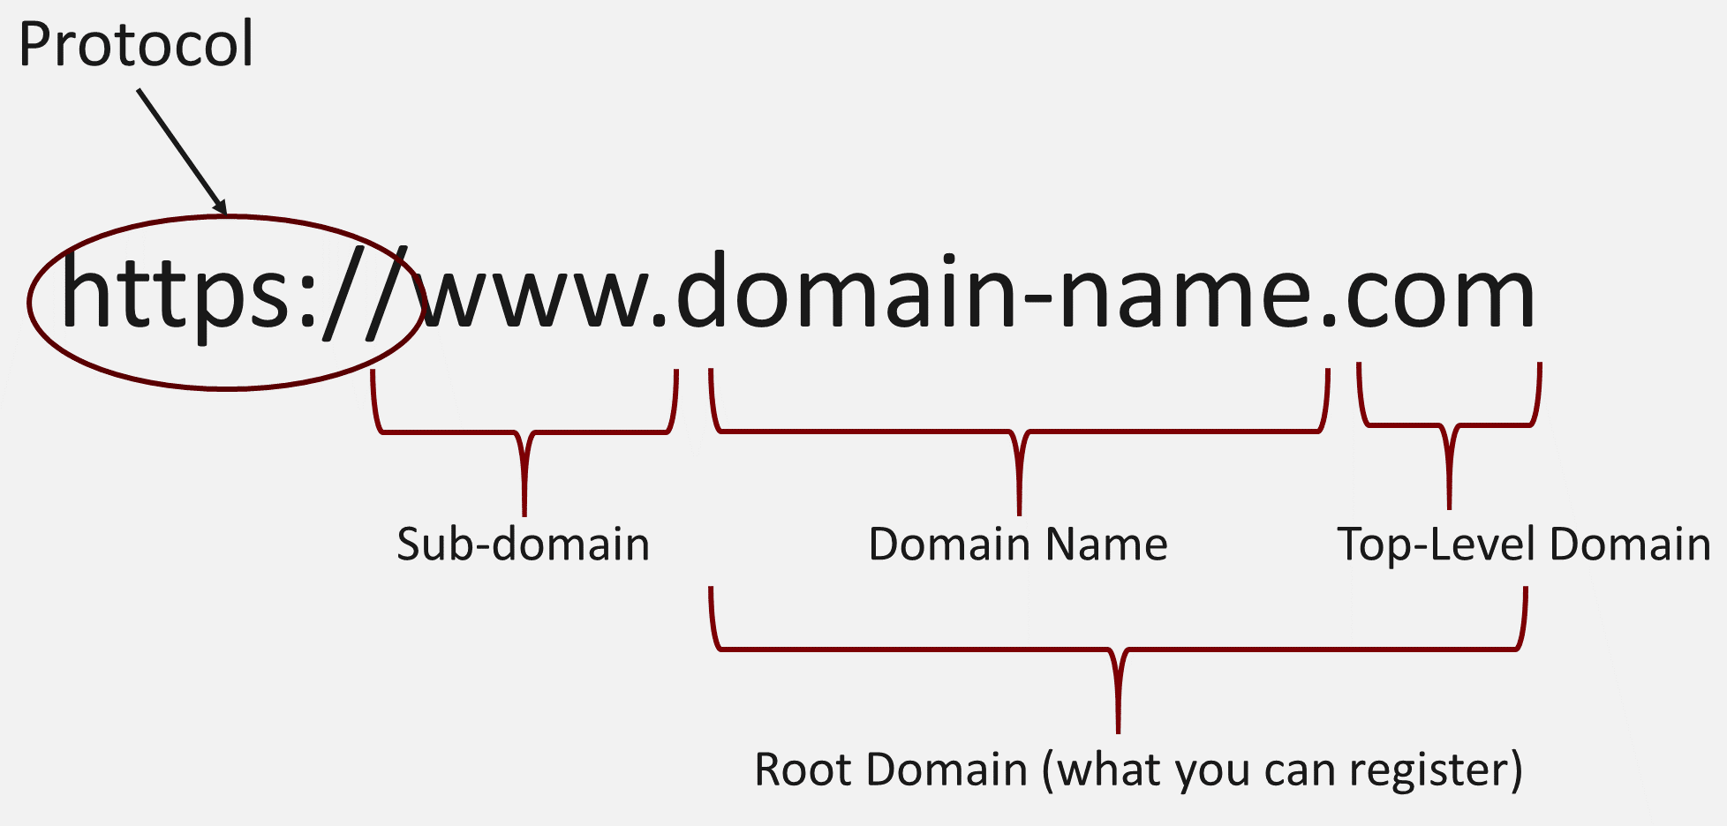
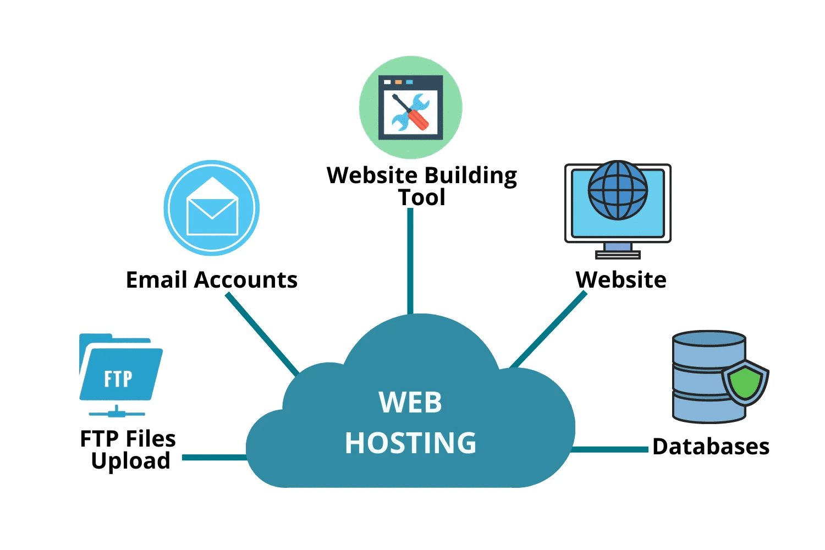
DOMAIN
DPPPAsumbar.com
HOSTING

